Slide 1


Deep Learning Techniques for Forecasting and Anomaly Detection of Large Multivariate Time Series in Real World Data
University of Verona - Department of Computer Science
Candidate: Francesco Ghezzo VR496402
First supervisor: Daniele Meli
Second supervisor: Alberto Castellini
Third supervisor: Emanuele Chini
Master’s degree in Artificial Intelligence LM-18

Slide 2
Motivation
Background:
IoT-connected heating systems generate vast amounts of time-series data.
Forecasting and anomaly detection are crucial for system efficiency and reliability.
Challenges:
Data variability, data imbalanced and missing values.
Features reduction.
Selecting the right model balancing accuracy and computational cost.

Slide 3
Research objectives and contribution
Analyze real-world IoT data from heating systems
Compare traditional MACHINE LEARNING with DEEP LEARNING models
Evaluate trade-offs between accuracy and efficiency

Slide 4
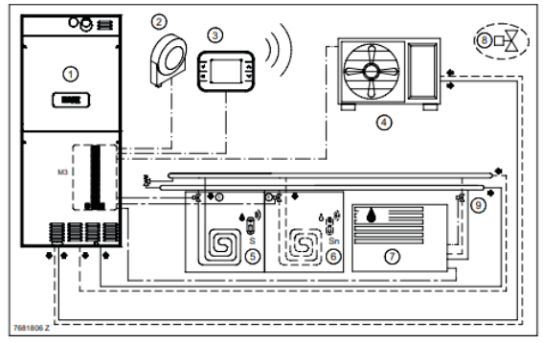
Dataset Overview
Source: IoT-connected heating systems (boilers, heaters, hybrid systems) from BAXI and Giordano Controls.
Dimension: ~340 features, with a total of 1.5TB of data collected over six months.
Features: Temperature, energy consumption, operational status, etc…, along with 20 dedicated features for anomaly labels.
Challenges:
- Missing data and anomaly imbalance
- Data noise
- High-dimensional multivariate time-series complexity

Slide 5
Data Preprocessing
Initial features of the dataset ~ 340.
Removing irrelevant non-numerical features (e.g., heater geolocation) 340->260
Collapsing anomalies columns to one “CODE” column. 260->240
Feature selection using PCA. 240->15/20
Time-series reduction by frequency resampling with fast Fourier transformation.

Slide 6
Methodology
Machine Learning models:
Support Vector Machine (SVM),
Random Forest (RF).
Deep Learning models:
Long Short-Term Memory (LSTM)
Temporal Convolutional Networks (TCN),
FEDformer¹
Evaluation Metrics:
- Forecasting: Normalized Mean Absolute Error (NMAE), Normalized Root Mean Squared Error (NRMSE).
- Anomaly Detection: accuracy, precision, recall, F1-score, AUC, time elapsed.

Slide 7
Dataset split
The dataset is divided as follows:
60% data in training with no anomalies
20% data in validation with no anomalies
20% data in testing (contains all anomalies, with a 50-50 split of normal and anomalous data)
Sliding window technique for time-series modelling

Slide 8
Sliding window approach
The sliding window technique is essential for capturing temporal dependencies in time series data, ensuring that models can learn from past observations to predict future patterns.
It also allows for a structured approach to anomaly detection by defining clear observation and detection periods, improving the model's ability to distinguish normal behaviour from anomalies.

Slide 9
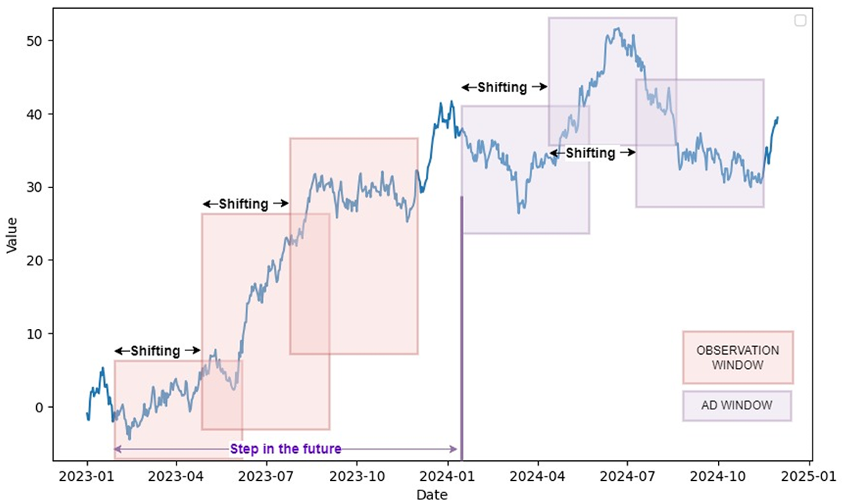
Sliding window approach
Sliding window technique incorporates four distinct variables:
Observation window size;
Anomaly detection window size;
Shifting: the number of time steps by which the window moves (default = 1)
The number of future time steps, representing the distance between the observation window and the anomaly detection window.

Slide 10
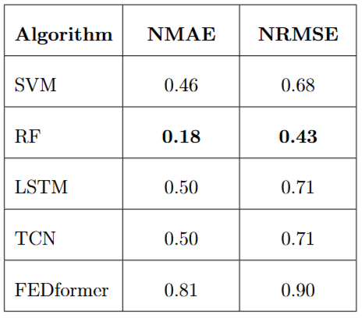
Results Forecasting
Deep learning models exhibit suboptimal performance due to the imbalance in anomaly distribution.

Slide 11
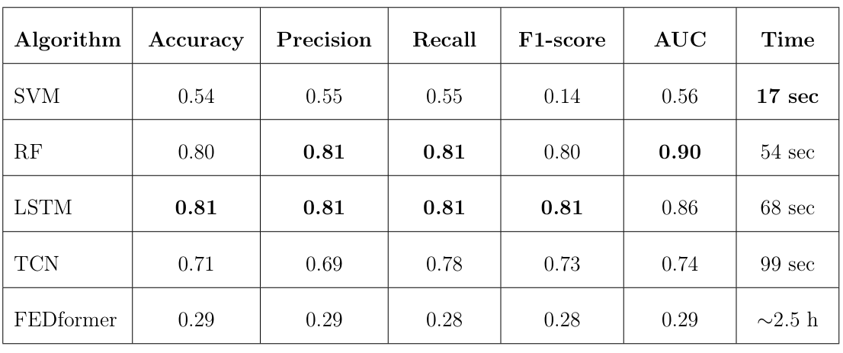
Results Anomaly Detection
As we saw in the forecasting results, RF still performs well in anomaly detection.
LSTM in this case, achieve better performance due to his capability to learn underlying pattern for the anomalies.

Slide 12
Conclusion
Deep learning has advanced time series forecasting and anomaly detection, but traditional machine learning models remain highly relevant due to their efficiency, cost-effectiveness, and interpretability.
Model selection should not be based solely on complexity or theoretical advancements but should consider practical constraints such as computational cost, sustainability, and transparency.
Future research should focus on:
Refining model selection strategies for different applications.
Addressing dataset integrity and ensuring benchmark reliability.
Developing optimized methodologies to balance predictive accuracy, efficiency, and interpretability.
A thoughtful, context-driven approach to AI model selection is essential for meaningful progress in time series analysis.

Slide 13
Key insight
Dataset Reliability & Benchmarking Issues:
Research has shown that many commonly used benchmark datasets in time series anomaly detection suffer from flaws, leading to misleading evaluations.
This study reinforces concerns that deep learning models may not always generalize well to real-world applications, emphasizing the need for more robust and well-validated benchmarks.
Reference: “Current Time Series Anomaly Detection Benchmarks are Flawed and are Creating the Illusion of Progress”, IEEE Transactions on Knowledge and Data Engineering, 2021

Slide 14

Thank You for Your Attention!
If you have any questions, I would be glad to discuss them

